Slide 1
Vaccination Policy
in the Workplace
April 9, 2021 Via Zoom
Steven L. Schwarzberg, Esq.

Slide 2
Employers Are Reopening!!!
The U.S. has administered the most coronavirus vaccine doses in the world, with more than 40% of adults and 75% of seniors at least partially inoculated—

Slide 3
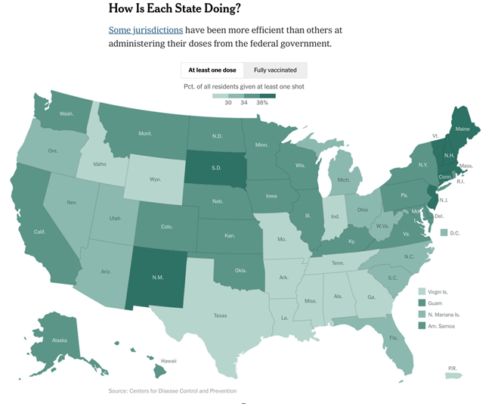

Slide 4
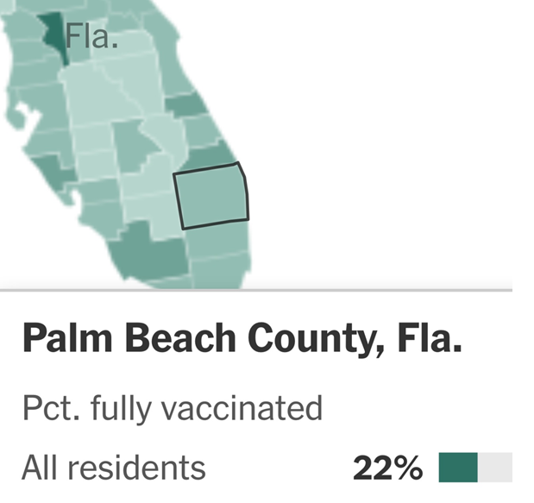

Slide 5
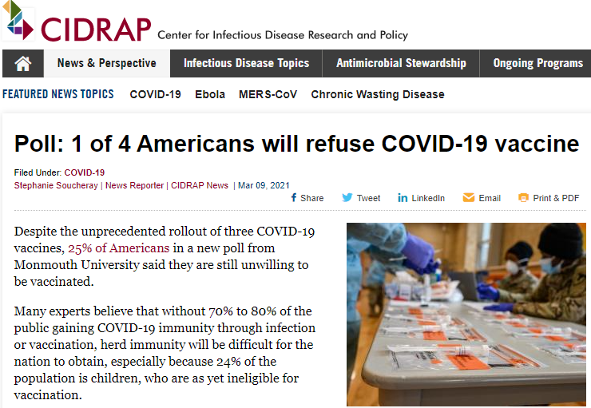

Slide 6
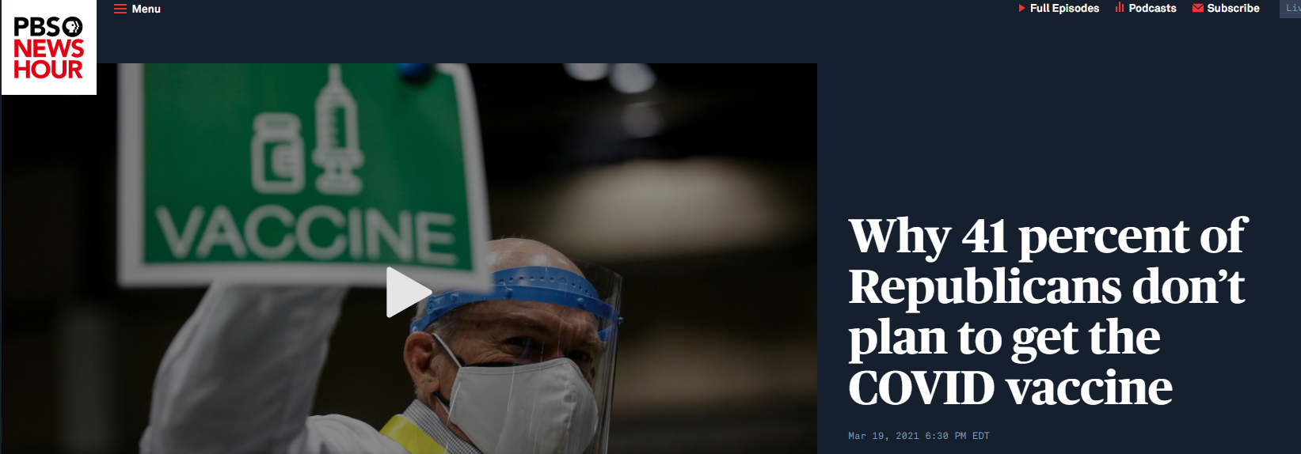

Slide 7
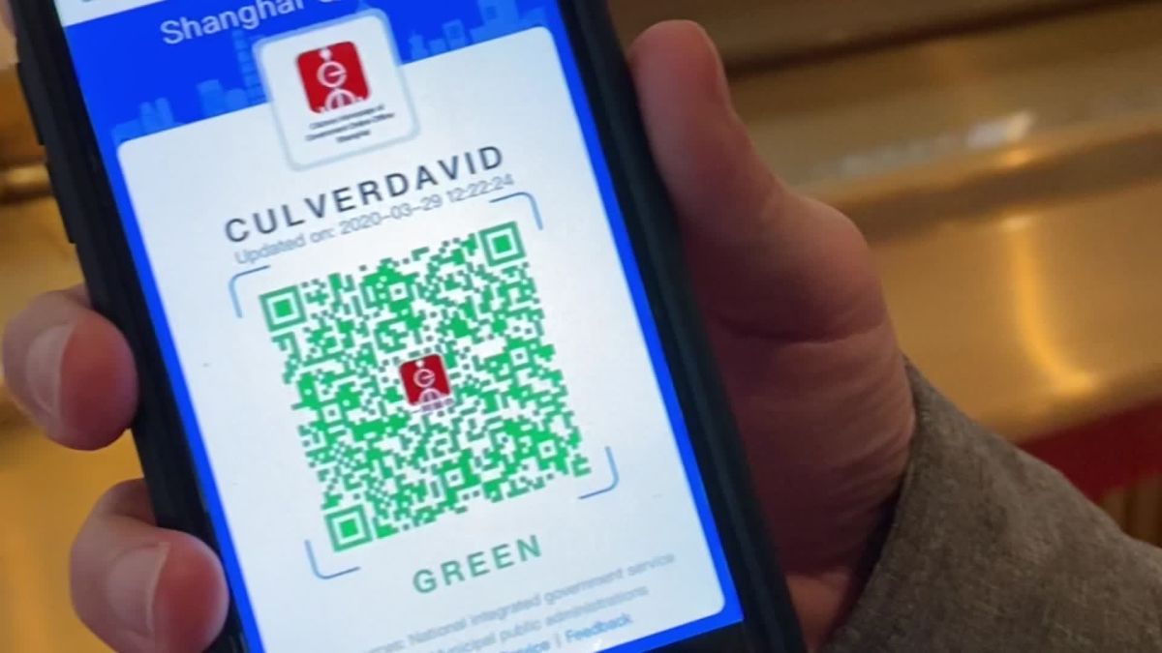
The Potential Immune-based Workforce and Privacy and HIPAA Issues it Would Create
A more robust re-opening process may require something akin to an immune-based workforce as its base—because a large-enough percentage of the workforce has been previously exposed, vaccinated or maybe we’ve reached herd immunity (70-80%???). Question: will we need to adopt protocols and will our governmental leaders and the courts allow it? Will public opinion allow it? Our medical experts state that we’ll first need to know the degree to which the virus is still a threat to our society, and how many people may have developed immunities, so we can plan intelligently. We don’t yet have a system we can implement and monitor to determine who might be healthy enough and eligible to return to work.

Slide 8
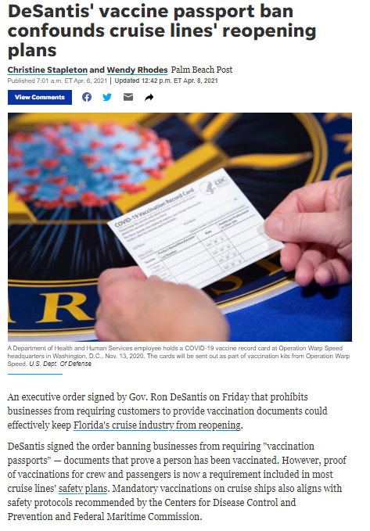
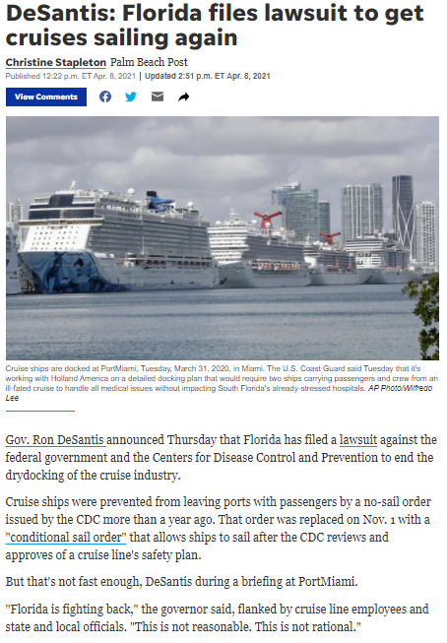
April 6, 2021
April 8, 2021

Slide 9
Reuters
UPDATE 1-WHO does not back vaccination passports
for now – spokeswoman
Tue, April 6, 2021, 7:11 AM·1 min read
(Add details, background)
GENEVA, April 6 (Reuters) - The World Health Organization does not back requiring vaccination passports
for travel due to uncertainty over whether inoculation prevents transmission of the virus, as well as equity
, a spokeswoman said on Tuesday.
"We as WHO are saying at this stage we would not like to see the vaccination passport as a requirement for
entry or exit because we are not certain at this stage that the vaccine prevents transmission," WHO spokeswoman Margaret Harris said.
"There are all those other questions, apart from the question of discrimination against the people who are not able to have the vaccine for one reason or another," she told a U.N. news briefing.
The WHO now expects to review China's COVID-19 vaccines Sinopharm and Sinovac for possible emergency use listing around the end of April, Harris said.
"It's not coming as quickly as we had hoped because we need more data," she said, declining to provide more information, citing confidentiality.
WHO director-general Tedros Adhanom Ghebreyesus appealed last month to countries with excess vaccine supplies to donate 10 million doses urgently to the COVAX facility which it runs with the GAVI vaccine alliance. Export restrictions by India left the vaccine-sharing programme short of supplies of AstraZeneca's vaccine made by the Serum Institute of India.
Harris said she had no update on any countries stepping forward, adding: "We are very much looking for more vaccine"

Slide 10
It’s unlikely government will impose vaccination requirements in the workplace
Maybe individual businesses or industries will set the pace,
What should your customized policy be in the workplace?
Mandatory;
Encouraged (with incentives and Employer assistance); or
Voluntary??
One size does not fit all, so consider:
Pros and Cons applicable to your business, staff or industry;
Allowing Exemptions based on ADA/Disability factors, Religious Beliefs;
State and Local laws; and
Avoiding Retaliation claims under the NLRA

Slide 11
EEOC’s policy is that employers can test workers for COVID-19
(Reuters) - The U.S. agency that enforces civil rights laws against disability discrimination said on Thursday that companies can test employees for COVID-19 before permitting them to enter the workplace as long as the tests are accurate and reliable.
The Equal Employment Opportunity Commission (EEOC) last month said employers may take workers’ temperatures without violating the Americans with Disabilities Act (ADA), but Thursday’s guidance appears to authorize a broader array of testing options.
The commission said mandatory medical testing, which is generally prohibited by the ADA, is allowed if it is “job related and consistent with business necessity.”
Applying that standard, the new guidance allows employers to take steps to determine if employees entering the workplace have COVID-19, the illness caused by the novel coronavirus, because the virus poses a “direct threat” to the health of others.

Slide 12
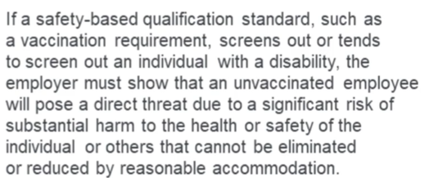
EEOC Vaccination Guidance
Can employers require vaccinations without violating discrimination laws? YES, if done right.
Employers must accommodate employees with:
disabilities,
pregnancies and
sincerely-held religious beliefs

Slide 13
WHAT IF AN EMPLOYEE REFUSES TO BECOME VACCINATED:
If employee refuses vaccination, the employer can’t exclude the employee from the workplace unless
there is no way to provide an reasonable accommodation (except if doing so creates an undue hardship—
hard to prove nowadays) that would reduce or eliminate the risk of substantial harm to the employee or others
Consider other alternatives under the ADA, FMLA, leave policies, re-assignment, working off-site, flex-shifts,
keeping distance, shields, etc., etc.

Slide 14
What factors should an employer consider to evaluate whether an
unvaccinated employee posed an undue hardship or direct threat sufficient to justify excluding the employee? Consider:
What percentage of all workers have been vaccinated already?
How much contact do employees have in the workplace?
How much do employees interact with clients, visitors, etc.?
What other protections are in place (shields, staggered shifts, social distancing, etc.?)
How much interaction is there with any vulnerable populations?

Slide 15
Beware unwittingly making improper disability-related medical inquiries
Is merely asking if an employee has been vaccinated is not an improper “medical inquiry,” but
if the employee has not been vaccinated, asking WHY NOT, may be a violation. Any such inquiries
must be job-related and consistent with business necessity.
You can ask for proof of vaccination, but make sure the employee doesn’t offer more information that that.
Avoid any discussions about genetics (in violation of the federal statute “GINA.”

Slide 16
Handling Employees with vaccinations:
Keep those records separate from other personnel files
Remind employees to comply with other safety precautions:
Testing;
Screening;
Taking temperatures;
Face covering
Hand washing;
Avoiding congregating; etc.

Slide 17
Employers may encourage vaccinations:
Offer information, PTO, financial incentives, leave to recuperate, etc.

Slide 18
Practice Tips:
Communicate with your employees and become aware of any need to consider accommodations;
Engage in the interactive process;
Document communications and keep a record of efforts to comply;
Appoint someone to oversee requests for accommodations;

Slide 19
Beware the Whistleblower and Avoid Retaliation in all of its forms
Employees will have a lot to complain about! An employee who objects to an employer violating a law, rule or regulation and who suffers an adverse employment action as a result, may bring a claim for retaliation and can recover damages and attorneys’ fees under Florida’s private whistleblower statute. Fla.Stat. Section 448.101.
Similarly, employees who are retaliated against for making claims for overtime (even orally), workers compensation relief for an injury on the job (like being infected in an unsafe workplace), discrimination, harassment, or hostile work environment, leave under the regular Family Medical Leave Act (“FMLA”) or are denied benefits under protective statutes, or for discrimination, may also have retaliation claims—where they can seek recovery of the wages they lost.
Under current circumstances, an employer may get sued for not bringing back an employee from a furlough, layoff or reduction of pay if that employee had previously complained or objected to an employer’s legal non-compliance. With the ever-growing list of legal requirements facing employers, employees won’t run out of complaints and will sue if they suffer any adverse employment action.

Slide 20
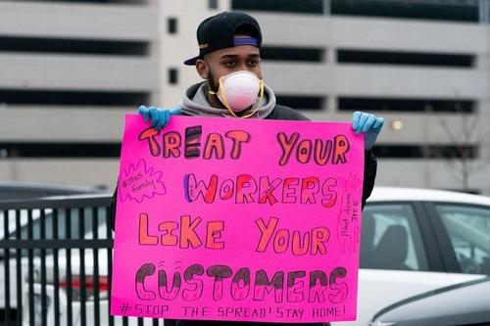
Few employers (including non-union employers) realize that they may become liable for retaliation under the National Labor Relations Act (“NLRA”) if they discipline employees for complaining about working conditions, because it may be deemed to be interference with that employee’s protected right to participate in concerted protected activity. An example may have occurred months ago, when Amazon fired, a worker who protested about unsafe workplace conditions due to concerns over Covid-19. Employers need to be VERY careful, now more than ever, whether, how and why they may take any adverse action against an employee (including, but not limited to, for example, not bringing the employee back from a furlough, layoff or reduction of pay). Now is the time to review whistleblower policies and establish hotlines in place to facilitate timely reporting, have thorough investigations conducted and avoid any retaliation.
For example, Amazon retaliated against, and fired, a worker who organized over Covid 19.

Slide 21
Discrimination Based on Potential Bias
in Applying a Vaccination Policy
Employers may get sued for mishandling its vaccination policy. For example, if an employer decided to make vaccinations mandatory and disciplined older workers, or those with pre-existing underlying conditions who are deemed more susceptible to infection, or pregnant workers, the employer could unwittingly be setting itself up to an age, gender, pregnancy discrimination and/or disability discrimination claim. Those who had previously taken leave under the FMLA, and were not brought back, could bring a retaliation claim.

Slide 22
Family Medical Leave (“FMLA”) Notice of Eligibility and the Americans With Disability Act (“ADA”) Interactive Process
Under the FMLA, if the employer knows or has reason to know an eligible employee has a serious health condition or may qualify for leave, the employer has an affirmative obligation to provide the employee with formal written Notice of Eligibility and Rights & Responsibilities.
Under the ADA, if the employer knows or has reason to know an employee has a disability or regards the employee as having a disability (physical or emotional), the employer has an affirmative obligation to engage in the “interactive process” to determine if a reasonable accommodation must be provided to the employee, unless the employer can prove that providing the accommodation sought by the employee would work a hardship on the employer’s business.

Slide 23
Insurance, Insurance, Insurance
Employers should immediately secure Employment Practices Liability Insurance (“EPLI”) in anticipation of an onslaught of lawsuits.
They may be able to sue their carrier if their claims for business interruption damages under their commercial property “all risk” insurance policies are denied.
Insurance brokers may be liable for not properly advising their clients to obtain adequate business interruption insurance or explaining the pitfalls of co-insurance.

Slide 24
MONITOR GOVERNMENT RESOURCES
TO STAY UP TO DATE:
CDC
OSHA
EEOC
DOL

Slide 25
steve@schwarzberglaw.com
561-371-2216
www.schwarzberglaw.com

